Slide 1

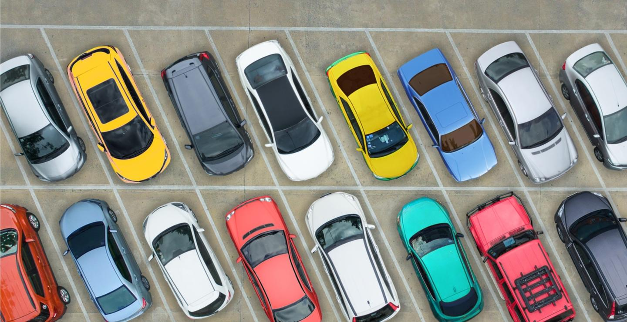
Parking reservation and management system
BY: SAISHEASHAN SN (RA2111013010005)
NISHOK VARSHAN M(RA2111013010010)
PROFESSOR: HEMA M

Slide 2
Abstract of the project
This project is about parking reservation and management system.
We can use this project to reserve parking in crowded market place , which saves us time to find the parking place.
Along with how much money has been made by the particular lot at any particular time/day/year.
The project uses the concepts of void function, switch , loops and flow control and operations.
Vehicle Parking Management System is based on the concept to generate Parking Vehicle’s records & update it.
Here User can add Vehicle detail (Vehicle type) in the program and it’s not time-consuming. This System makes easy to store records of each(Arrival & Departures of vehicles).
The whole project is designed in ‘C’ language and different variables and strings have been used for the development of this project.
This mini project is easy to operate and understand by the users. This simple mini project in C, built as a console application without using any graphics features.

Slide 3
Working of the project
The project is made of c programming concepts such as functions , loops, switch case etc.
When the output is received, it gives us 2 options, one being login as admin and other being sign in or sign up as user.
When admin is chosen , first we have to enter name and password as admin
We enter the admin interface. Here I can print the bill for the car/bike parked in the lot.
If we sign up and sign in by choosing 2nd option.
We enter user interface.
This is where the user can choose the type of vehicle and also the lot no they want to park
Car is designated lot no 1to 5 and bike is designated lot 6 to 10.

Slide 4
Admin LOGIN
In this project we take 2 type of vehicles(car, bike).
The advantage of this project is we can see what particular type of vehicle went out what time and how much is paid.
This information also helps in surveillance of the no of vehicle entering and exiting the parking
When the program is executed we get 6 choices:
The first choice is for car/jeep
Second choice is for bike/cycle
The third choice is for checking status
Is to clear the data
The last choice is to exit
When the respective choices for vehicles are chosen in the output we can see that the number of vehicles are added and the fare for the particular vehicle is also displayed.
This keeps on increasing as the vehicles come in.
The person can book his parking site before time
In the end of the day the number of vehicles entering and the fare for each of them can be stored.
The bill is stored in the file called old transaction.

Slide 5
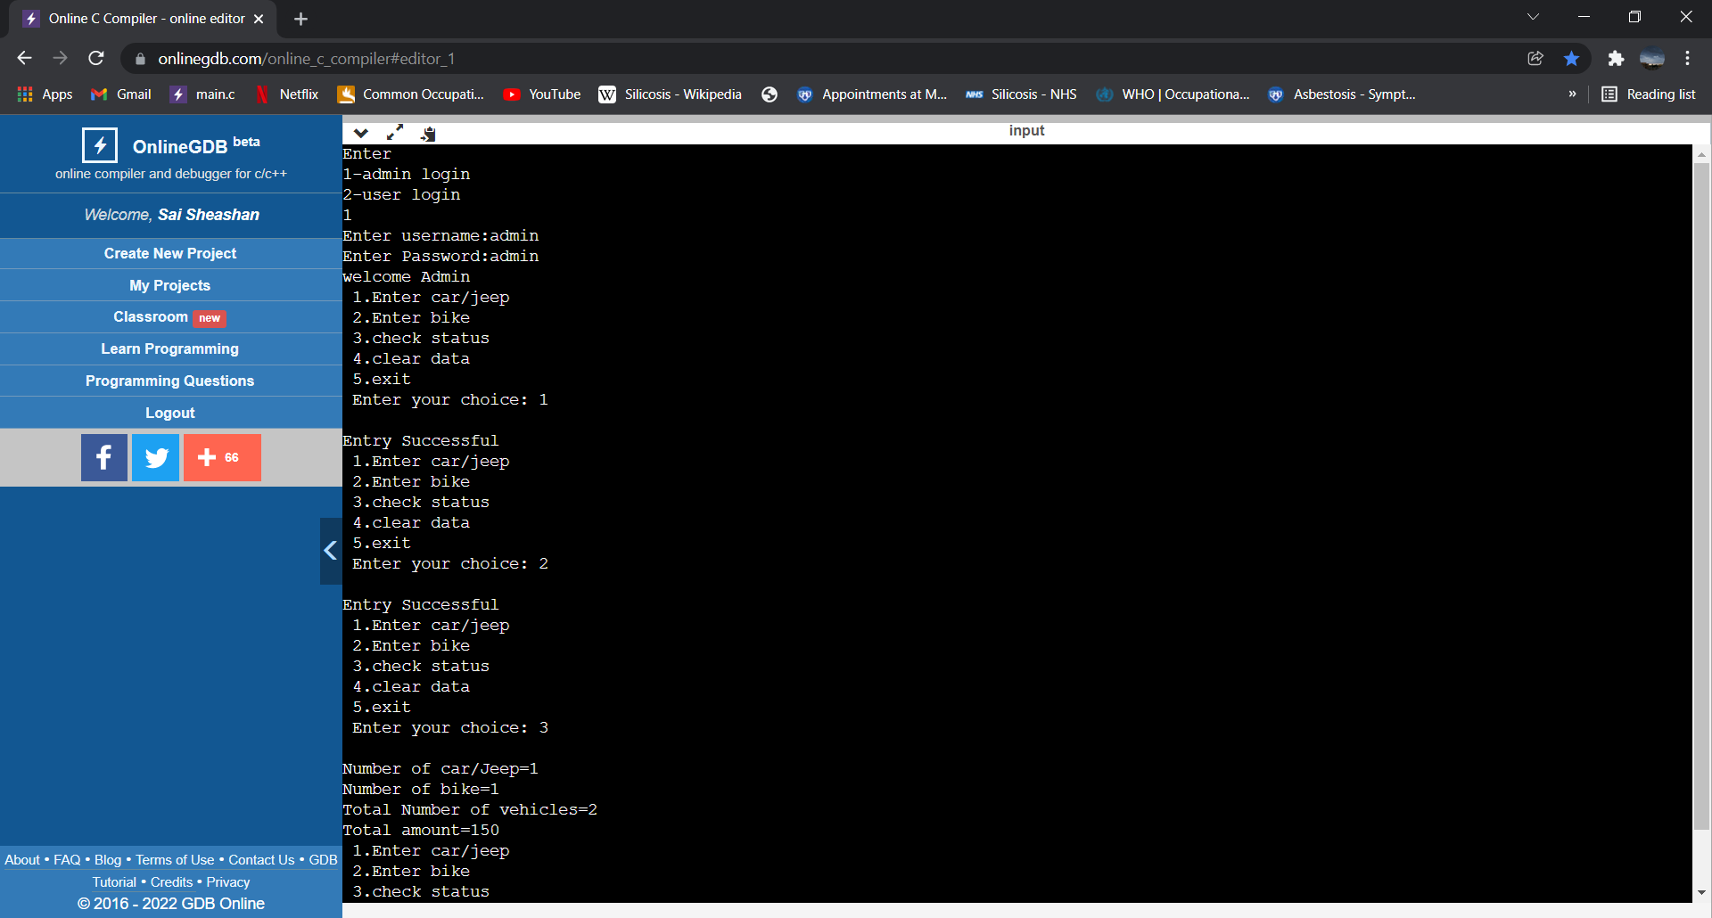
OUTPUT: ADMIN LOGIN

Slide 6
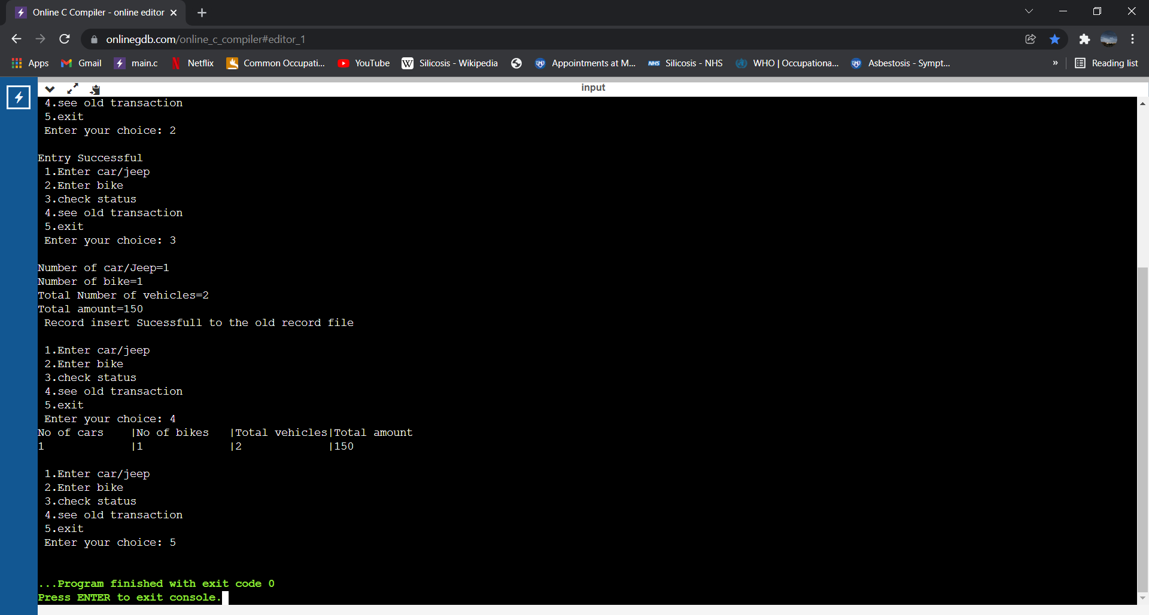

Slide 7
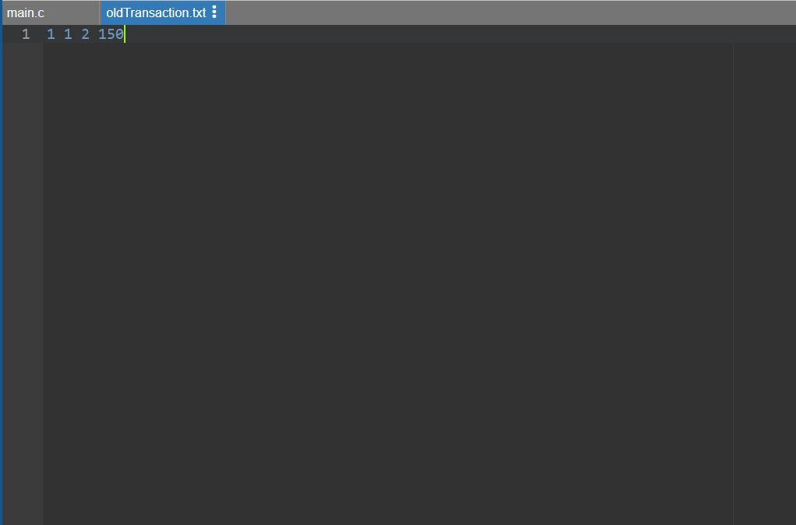
FILE: OLDTRANSACTION.TXT

Slide 8
User interface
To access user interface first we have to sign up and then sign in
There we have 2 option, 1st option is for car users and 2nd is for bike users
The user will have to pick a lot no from 1 to 5 for car and 6 to 10 for bike
If the lot is already booked it shows lot taken and user has to choose another lot.
The user name , password and the lot that has been booked are stored in the file named details.txt.
This allows them to sign in again and access their account.

Slide 9
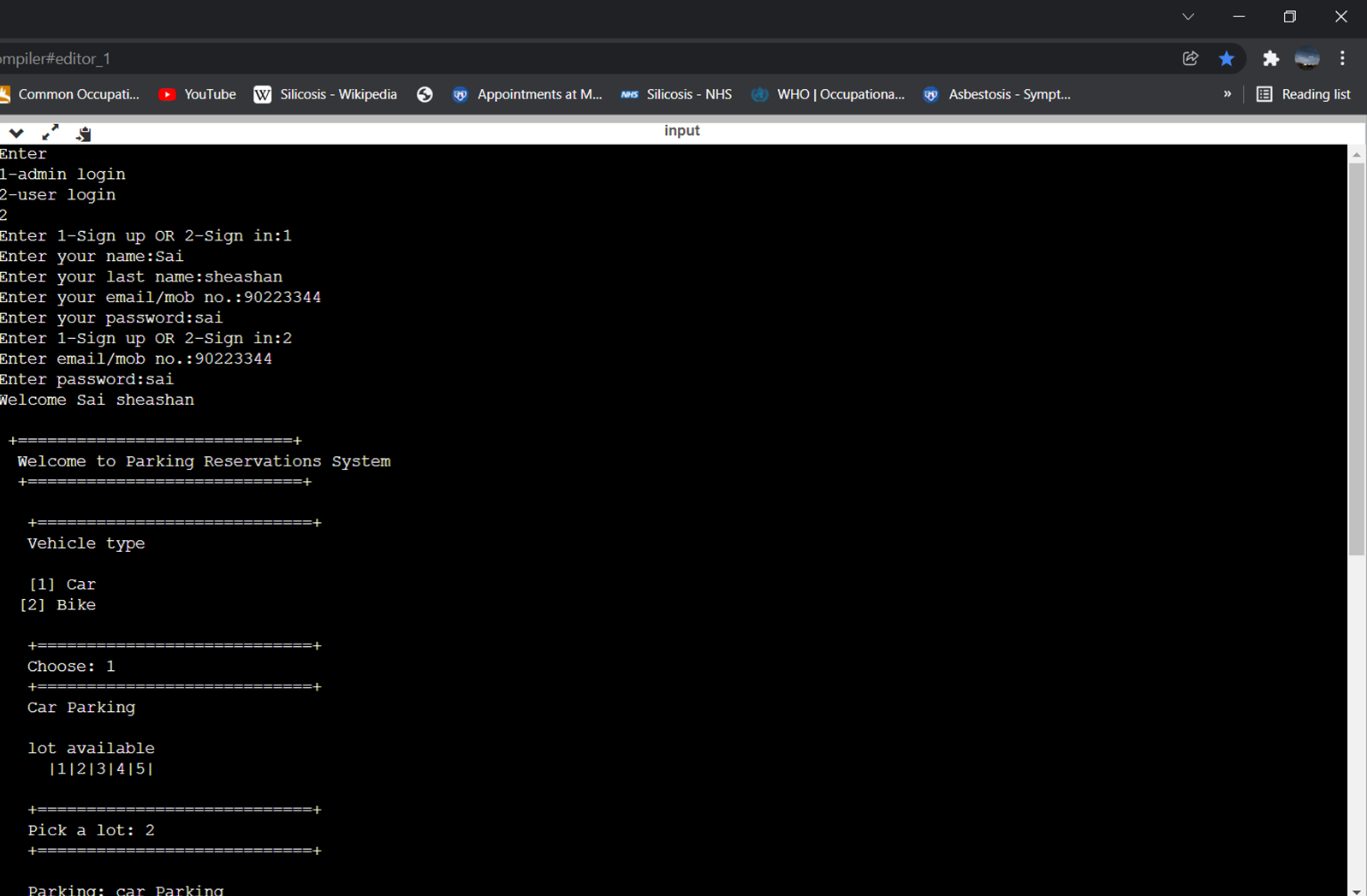
OUTPUT:USER LOGIN

Slide 10
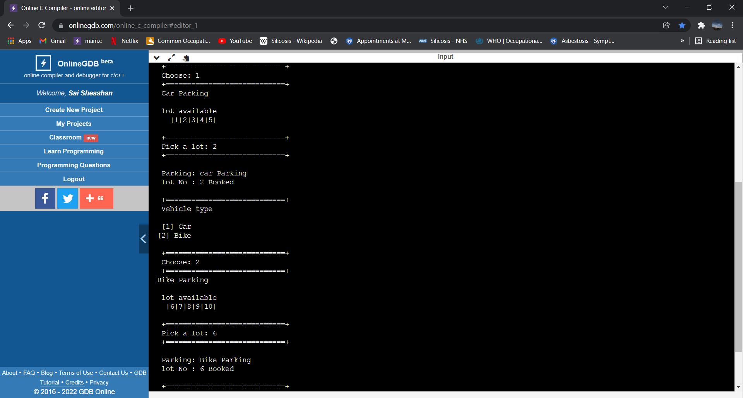

Slide 11
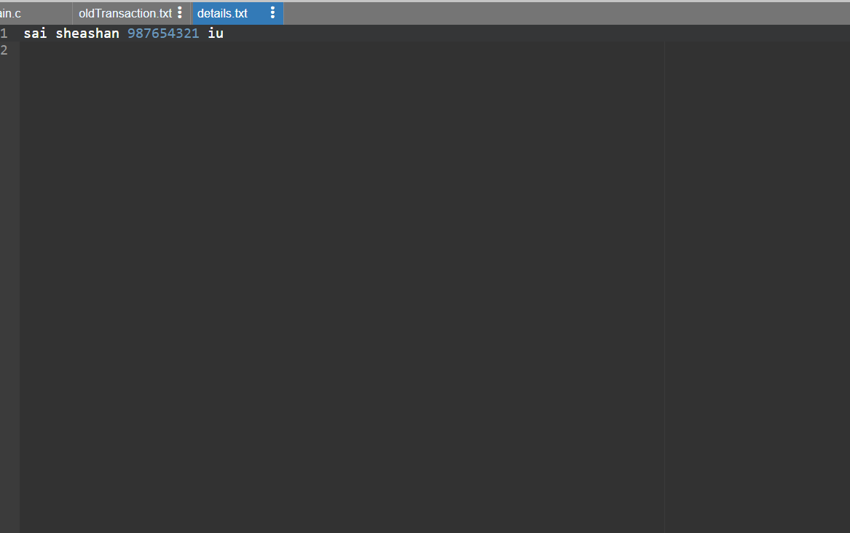
File: details.txt

Slide 12
Advantage of this program
The program is easy to code and execute
This does not require any external machine to work
This is purely software based
This requires supervision of a person ,thus provides employment
This helps us saving time in crowded market place by booking a parking lot very early thus saving time.
This is cost efficient.

Slide 13
Thank you

